Slide 1

YOUR LOGO
TalkingData Ad Tracking Fraud Detection
Team Members:
Zihan Zhang
Yipeng Hong
Yidi Xu

Slide 2
Content
Introduction
Background
Algorithms
Code Snippet
Result
Discussion

Slide 3
01
Introduction

Slide 4
PART/01 Introduction
Notes:
We live in a digital world where all is available at the touch of a screen, with wifi, we could enjoy ourselves on the internet, exchange data and so on. However, click fraud can happen along with that, at an overwhelming volume.

Slide 5
PART/01 Introduction
Result:
Misleading Click Data
Wasted Money
Notes:
Ad channels can drive up costs by simply clicking on the ad at a large scale.

Slide 6
PART/01 Introduction
Understanding Algorithms to choose the better ones
Evaluating TalkingData Ad frauds that are predicted by the algorithms
Comparison of two output results: Sample VS Predicted

Slide 7
02
Background

Slide 8

PART/02 Background
What is Ad Fraud?
Defined as any deliberate activity that prevents ads from being served to human users
Effect?
Illegal bot activity
Historically fraudulent URLs
Specific page-level fraud
In China?
Suffers from huge volumes of fraudulent traffic, With over 1 billion smart mobile devices in active use every month.

Slide 9
PART/02 Background
TalkingData
China’s largest independent big data service platform
70%

Slide 10
PART/02 Background
10%
Regular
10%
90%
Regular
Potentially Fraudulent
90%
Potentially Fraudulent
Notes:
In order to always be one step ahead of fraudsters, we will build algorithms that predicts whether a user will download an app after clicking a mobile app ad.

Slide 11
03
Algorithms

Slide 12
PART/02 Creating Features
Extracting time information
extract day, minute, hour, second from the click_time
Confidence Rates for is_attributed
some ips, apps, devices, etc. might have higher frequencies of is_attributed
Time till next click
how long it takes for a given ip-app-channel before they perform the next click
Group-By-Aggregation
a lot of groupby -> count()/var()/mean() etc. feature engineering in the kernels
Clicks on app ad before & after
Has the user previously or subsequently clicked the exact same app-device-os-channel?

Slide 13
PART/03 Algorithms (ML & DL)
Logistic regression
LR
Support Vector Machine
SVM
Random Forest
EL
RS
Gradient Boosting & AdaBoost
GB & AB
Ensemble Learning
ANN
Artificial Neural Network

Slide 14
PART/03 Multi- Algorithm
35%
Algorithm 1
Algorithm 2
New
Algorithm
60%
15%
Algorithm 3
28%
Algorithm 4
New Algorithm
Compare each algorithm and find out the several best algorithms, allocate the percentage to each one and sum up these to create a new algorithm. Then we can get a new algorithm for the prediction

Slide 15
PART/03 Prediction
Sample Output
For comparison
Algorithm
Accuracy
For prediction
Output
Test.csv
Prediction
Dataset

Slide 16
04
Code Snippet

Slide 17
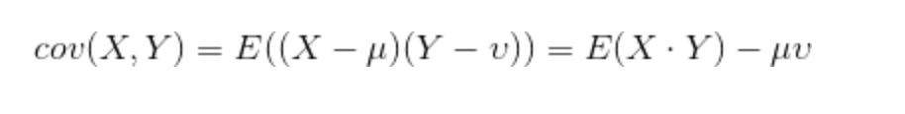
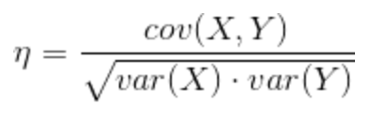
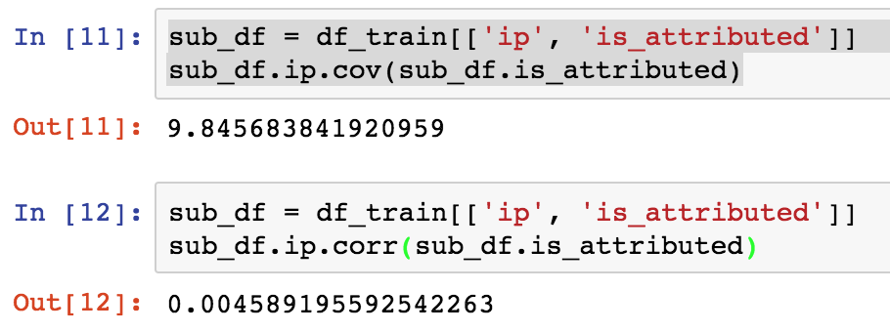
PART/04 Code Snippet
Any Columns Unrelated?

Slide 18
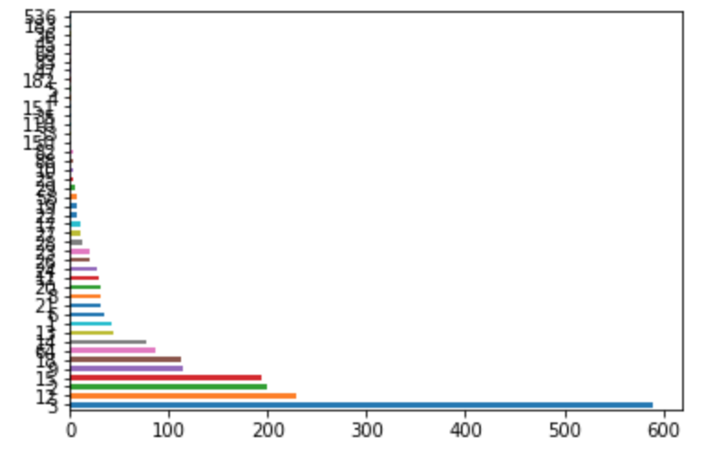
PART/04 Code Snippet
Analyze Attributed and Total number Distribution
df_train['app'].value_counts().plot(kind='barh')

Slide 19
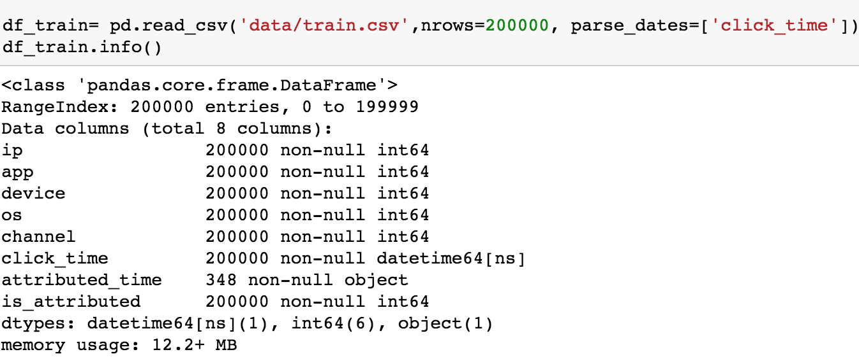
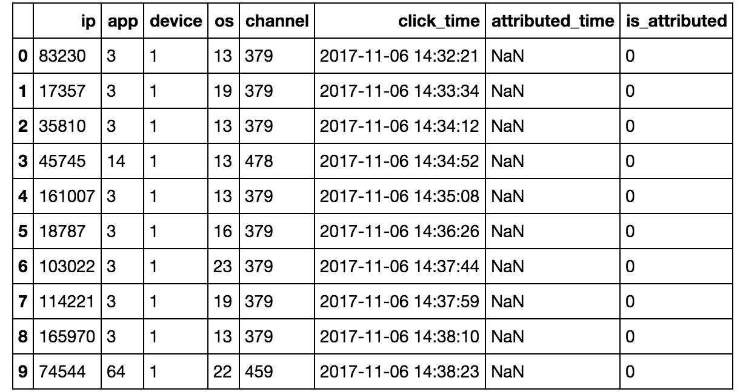
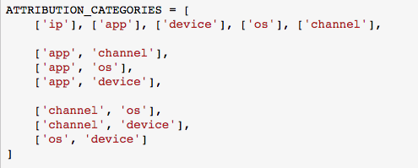
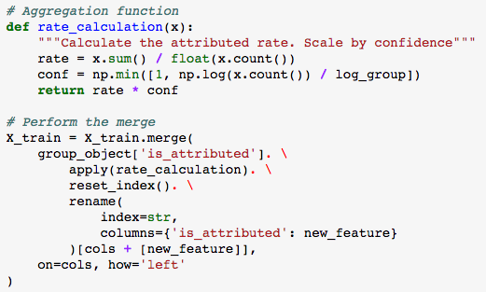
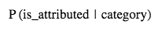
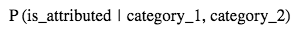
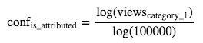
PART/04 Code Snippet
1. Load Data – subset of the dataset
2. Creating feature – time, confidence rates → X_train

Slide 20
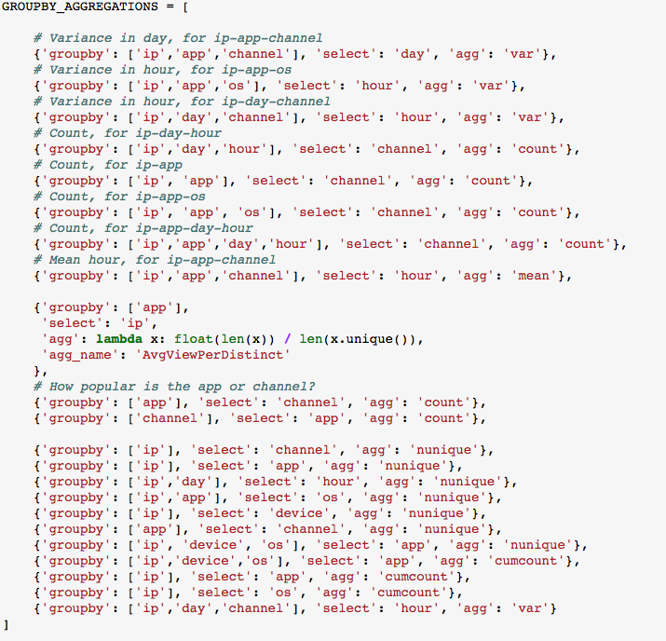
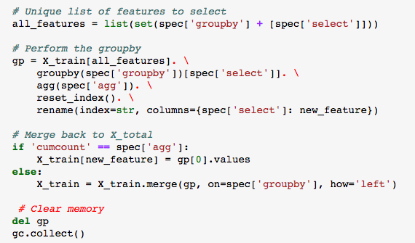
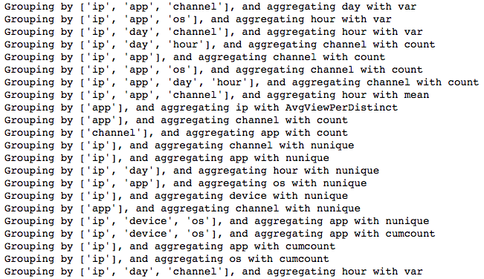
PART/04 Code Snippet
Group-By-Aggregation ( https://www.kaggle.com/bk0000/non-blending-lightgbm-model-lb-0-977 )

Slide 21
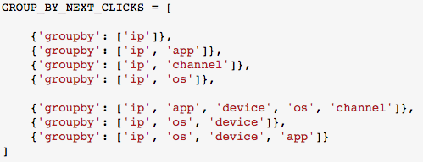
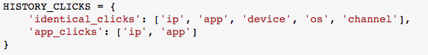
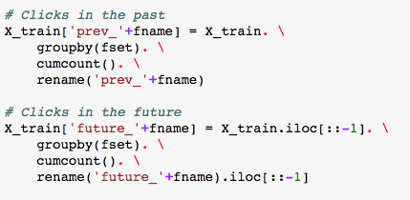
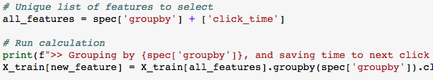
PART/04 Code Snippet
Time till next click
Clicks on app ad before & after

Slide 22
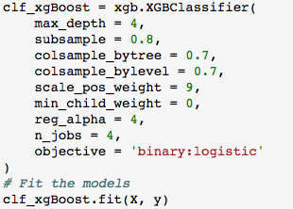

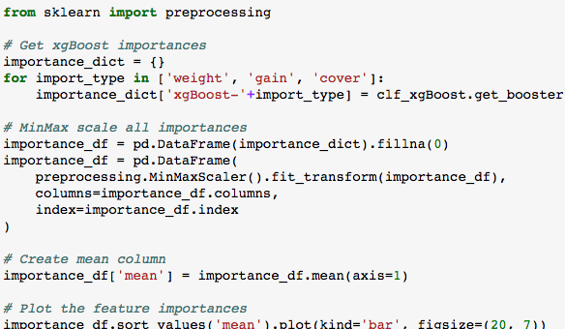
PART/04 Code Snippet
3. Evaluating Feature Importance (Params from: https://www.kaggle.com/aharless/swetha-s-xgboost-revised )
Create models
The feature importances are MinMax
scaled, put into a DataFrame, and finally
plotted ordered by the mean feature importance.
Make use of these features for the evaluation →
evaluate the impact of all features & predict the feature ‘is_attributed’

Slide 23
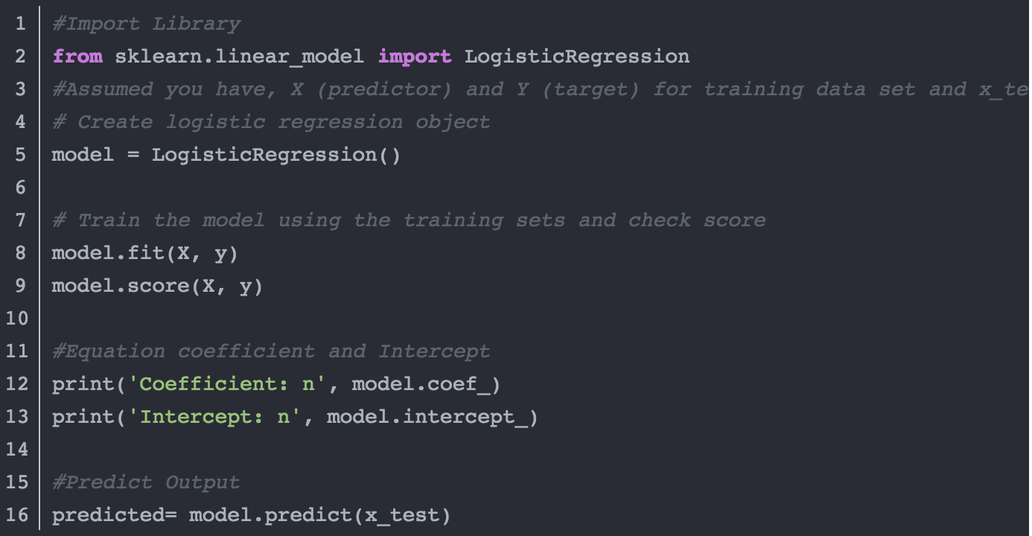
PART/04 Code Snippet
Logistic regression

Slide 24
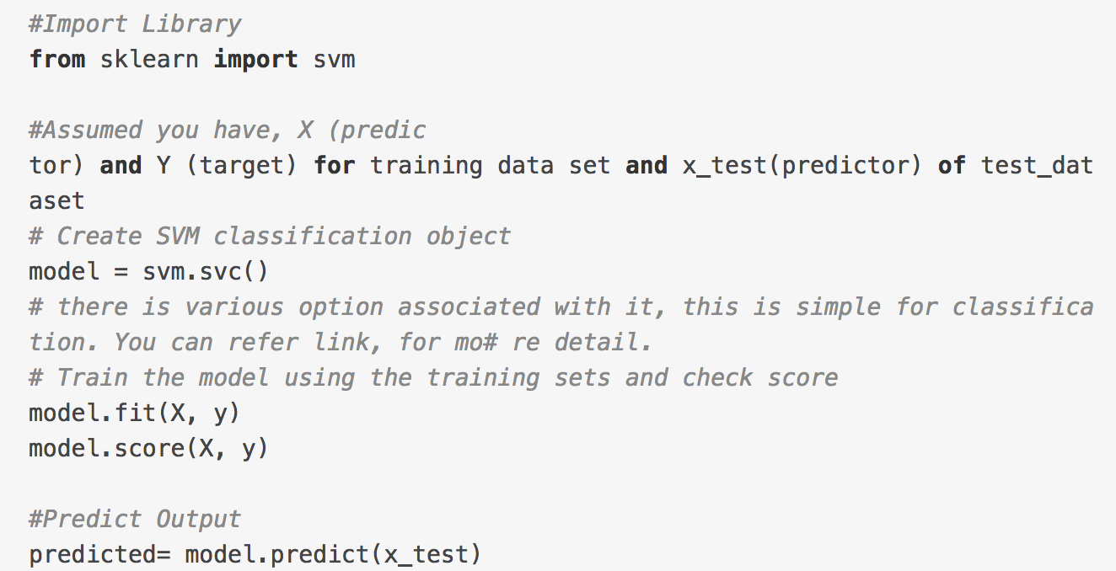
PART/04 Code Snippet
Support Vector Machine

Slide 25
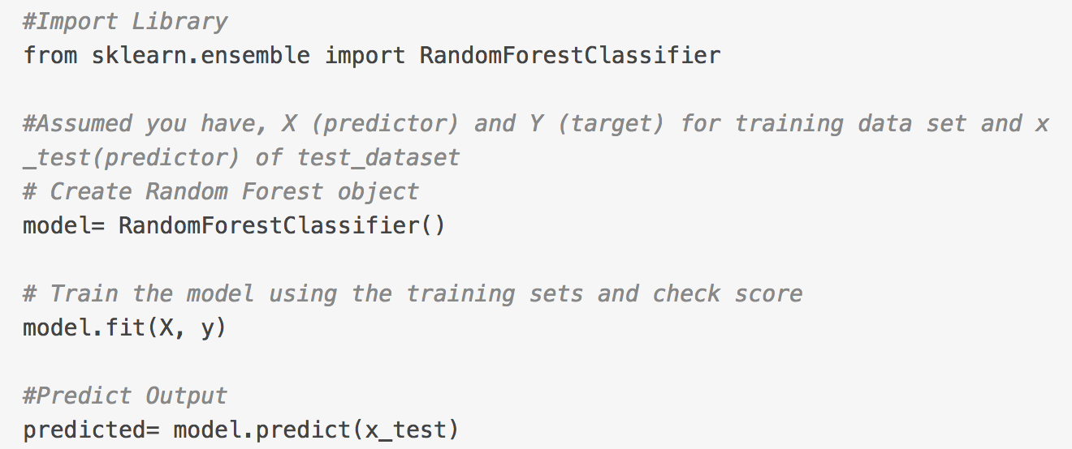
PART/04 Code Snippet
Random Forest

Slide 26
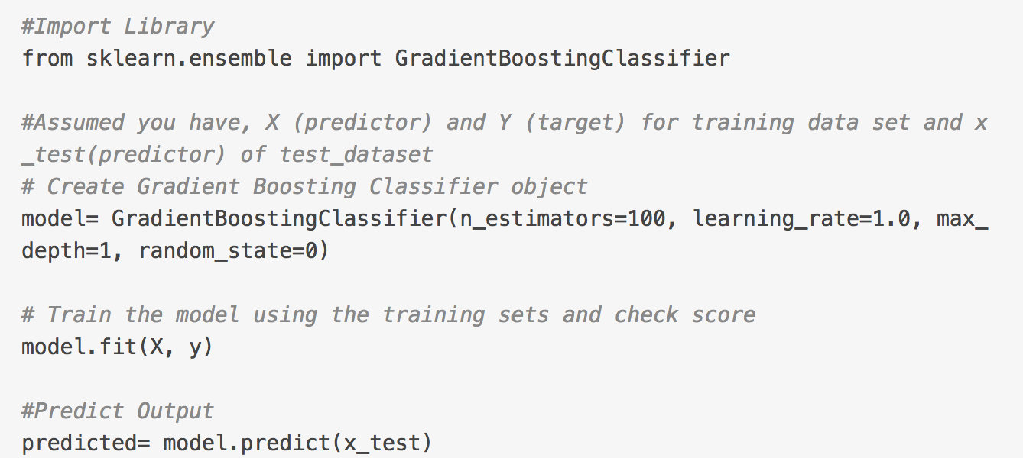
PART/04 Code Snippet
Gradient Boosting & AdaBoost

Slide 27
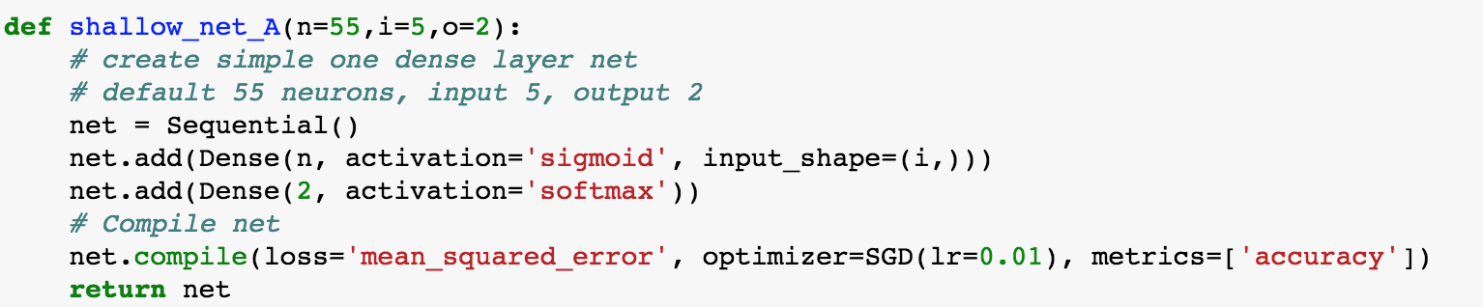
PART/04 Code Snippet
Artificial Neural Network

Slide 28
05
Result

Slide 29
PART/05 Result
Sample Output
For comparison
Algorithm
Accuracy
For prediction
Output
Test.csv
Prediction
Dataset

Slide 30
06
Discussion

Slide 31
PART/06 Discussion
Is there any other algorithm that can improve the prediction?
Is there any virtualization?
The best parameters for the model
Is there any shortcoming in the model?
Is there any way to improve the performance of the model?

Slide 32
THE END
THANKS

